Slide 1
2020/12/16 @ 10:38
Switch to LRMC-OL
C003 P127
2020/12/10 @ 12:32
Switch to LRMC-CL
C002 P230
2020/12/14
Orbit change manœuvre
from 5:10 to 5:25
C003 at P070-071 transition
30/11/2020
POS4 switch on
2020/12/10
Orbit change manœuvre
from 4:55 to 5:09
C002 at P221-222 transition
21/11/2020
Launch
C001
C002
C003
LRMC-CL
NRT PDAP v3.0
STC PDAP v3.0
NTC PDAP v3.0
1st data available
07/12/2020 @ 13:24 in NRT (C002 P153)
07/12/2020 @ 01:15 in STC (C002 P140)
30/11/2020 @ 14:26 in NTC (C001 P228)

Slide 2
2020/12/17 @ 19:38
Final orbit change
Sentinel-6 on Jason-3 orbit on C004 P011
2021/01/18
Star tracker update
C004
C005
C006
C007
LRMC-OL
NRT PDAP v3.0
STC PDAP v3.0
3.0
NTC PDAP v3.1
NTC PDAP v3.1
LR & HR C4 P014
2020.12.17 @ 22h17
PDAP v3.1
NRT only: correction COG error
All : calibration bias applied for WS computation

Slide 3

2021/01/26 @ 12:17 C008 P012
POS4 restart
C008 P012 to P060
Anomaly following restart on SAR-RMC data (-9m on range)
“This is explainable by the fact we did not update two parameters in the RDB immediately after the power cycle which were left with the ‘launch’ values.
The corrected parameters were uploaded on day 028 at 09:10 and took effect at 09:10:10.”
2021/02/25
POS4 restart
2021/02/04 @ 23:59
Mode mask activated on C009 P001
C008
C009
C010
C011
LRMC-OL
Mask 1
Mask 2
Mask 3N
NRT PDAP v3.0
NRT PDAP v3.1
STC PDAP v3.0
STC PDAP v3.1
NTC PDAP v3.1
NRT PDAP v3.1
LR & HR C8 P213
2021.02.03 @ 9h21
STC PDAP v3.1
LR C8 P194 2021.02.02 @ 14h50
HR C8 P184 2021.02.02 @ 5h28
NTC SAR
2021-02-09 @ 10:13:12
C009 P114
COG anomaly (1.06m) corrected
NTC LRM
2021-02-15 @ 01:42
C010 P005
COG anomaly (1.06m) corrected

Slide 4
AMR-C 24h Warm target Calibration from 17/03 09:36 to 18/03 09:38 (C13 P020-045)
Few radiometer data available over this period. Impact on atm att (~+5.5 dB), sig0, wind, ssb and iono..
C012
C013
C014
C015
Mask 4
No mask
LRMC everywhere
Mask 1
NRT PDAP v3.1
3.2
STC PDAP v3.1
3.2
NTC PDAP v3.1
HR NTC Reprocessed to v.3.2.5 (F02)
NTC PDAP v3.2
STC
2021-03-08 @ 01:46
C012 P035
COG anomaly (1.06m) corrected
NTC PDAP v3.2
LR & HR C13 P011 2021.03.17 @ 01h15
NTC Patch v3.2
C14 P013
2021-03-27 01:06:44
NRT PDAP v3.2
LR & HR C15 P227 2021.04.14 @ 8h21
STC PDAP v3.2
LR C15 P218 2021.04.14 @ 23h29
HR C15 P203 2021.04.14 @ 09h06
PDAP v3.2
LUT update + LR config update
→ Anomaly on STC and NTC C-band and MLE3 data (due to incorrect mispointing files)

Slide 5
POS4 restart on the :
4/05/2021 ?
12/05/2021
2021.05.21
Deep sky calibration ARM (pitch manœuvre 80 deg)
Satellite switched off for satellite software patch
Lack of data from 27-04-2021 @ 3:35 to 28-04-2021 @ 17:07
Cycle 17 track 47 to 87
Few tracks in full LRM-OL over this period
2021.04.22 @ 13:24:01
POS-4 restart
Xman
24/05: Xman -0.4 deg
25/05: Xman +0.4 deg
Xman
C016
C017
C018
C019
Mask 1
Mask 1
Mask 2
Mask 3N
NRT PDAP v3.2
STC PDAP v3.2
NTC PDAP v3.2
NTC PDAP v3.2.5
HR NTC Reprocessed to v.3.2.5 (F02)
STC Patch v3.2
C16 P183 2021.04.22@ 12:20
NTC PDAP v3.2.5
LR & HR C17 P020 2021.04.26 01h35
PDAP v3.2.5
Wind Speed & SSB tables update
HR configuration update

Slide 6
NTC: POE-F update from cycle 22: DORIS+GPS orbits with blocked GPS phase ambiguity
C020
C021
C022
C023
Mask 4
No mask
LRMC everywhere
Mask 1
3.2
NRT PDAP v3.2.5
STC PDAP v3.2.5
NTC PDAP v3.2.5
NRT PDAP v3.2.5
LR & HR C20 P033 2021.05.26 08h23
STC PDAP v3.2.5
LR & HR C20 P001 2021.05.25 01h43
PDAP v3.2.5
Wind Speed & SSB tables update
HR configuration update

Slide 7
J3 : AMR calibration scheduled on June 22nd 2021 at 06:31:53 UTC
19/07/2021 @ 19h59:18
Deep-sky calibration AMR
→ ~C025 P158
C024
C025
C026
C027
Mask 1
Mask 2
Mask 3S
Mask 4
NRT PDAP v3.2
NRT PDAP v3.3.2
STC PDAP v3.2
STC PDAP v3.3.2
NTC PDAP v3.2.5
NTC PDAP v3.3.2
NTC PDAP v3.3.2
LR C24 P251
2021.07.13 11h51
NRT PDAP v3.3.2
C27 P21
LR: 2021.08.03 06h59
HR: 2021.08.03 07h05
NTC PDAP v3.3.2
HR C24 P223
2021.07.12 09h37
STC PDAP v3.3.2
LR & HR C26 P244
2021.04.26 01h35
PDAP v3.3.2:
Update BUFR encoding
L2 CONF update : AlphaPMean (impact on sig0 → calibration bias for WS adjusted) + use platform attitude again
In OPE : 2021-08-03

Slide 8
POS-4 Application Software (ASW) onboard Sentinel-6 will be upgraded to version 2.4 Thu 26 Aug, expecting to cause one obit of altimetry data outage from 09:51:43 to 11:48:04 UTC.
14/09/2021 @ 09:00
Switch to POS-4 side B
26/08/2021 @ 10:00
POS-4 restart
STC : sigma0 +3.2 dB → SSHA -1.4cm on the 26/08 (from cyc 29 track 97 to 123) than back to normal
Mode mask switch to LRM-OL over few tracks (from track 82 to 109) to allow switch to POS4B
C028
C029
C030
C031
LRMC everywhere
Mask 1
Mask 2
Mask 3S
NRT PDAP v3.3.2
STC PDAP v3.3.2
NTC PDAP v3.3.2
CAL anomaly until cycle 31 track 102 in STC

Slide 9
C032
C033
C034
C035
LRMC everywhere
NRT PDAP v3.3.2 (F03)
STC PDAP v3.3.2 (F03)
NTC PDAP v3.3.2 (F03)
NTC PDAP v3.4 (F04)
STC
RED CHAR update
C034 P185
18-10-2021 @ 01:46
NRT
RED CHAR update
C034 P218
19-10-2021 @ 08:41
NTC
RED CHAR update
C032 P027
22-09-2021 @ 01:47
NTC PDAP v3.4
LR & HR C034 P003
10.10.2021 @ 23:15
PDAP v3.4 (F04) :
Correction of the CAL anomaly (date of processing used instead of date of measurement) → strong impact on NTC

Slide 10
2021/11/19
Calibration : rotation of 90° in yaw:
from 03:52 to 04:50 (C037 P245) and
from 16:09 to 17:10 (C038 P004)
Expected degraded altimetry products.
2021/12/04 @ 21:34
AMR Interal CAL
C036
C037
C038
C039
LRMC everywhere
NRT PDAP v3.3.2 (F03)
NRT PDAP v3.4 (F04)
STC PDAP v3.3.2 (F03)
STC PDAP v3.4 (F04)
NTC PDAP v3.4 (F04)
STC PDAP v3.4
LR & HR C36 P215
2021.11.08 01h49
NRT PDAP v3.4
C36 P247
LR: 2021.11.09 08h30
HR: 2021.11.09 08h19
PDAP v3.4 (F04) :
Correction of the CAL anomaly (date of processing used instead of date of measurement) → strong impact on NTC

Slide 11
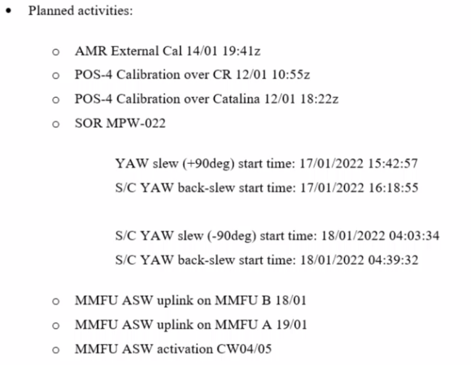
2021/12/09
AMR Interal CAL
Yaw manoeuvre
2021/12/14 @ 19:38
AMR Interal CAL
2021/12/16 @ 01:42
AMR External deep sky calibration
2022/01/14 @ 19:41
AMR Interal CAL
C040
C041
C042
C043
LRMC everywhere
NRT PDAP v3.4 (F04)
STC PDAP v3.4 (F04)
NTC PDAP v3.4 (F04)

Slide 12
Yaw manoeuvre
2022/02/02 @ 17:09
AMR Interal CAL
2022/02/03 from 15:19 to 15:32
Instrument maintenance leading to data gaps
2022/01/28 @ 17:24
AMR Interal CAL
POE-F update (NTC)
C044
C045
C046
C047
LRMC everywhere
NRT PDAP v3.4 (F04)
STC PDAP v3.4 (F04)
NTC PDAP v3.4 (F04)
NTC PDAP v3.5 (F05)
NTC PDAP F05
LR & HR C046 P006
07.02.2022 @ 01:46

Slide 13
Yaw flip manoeuvre
2022/02/27 from 15.54 to 16:04
C048 P025
Yaw flip manoeuvre
2022/03/03 from 17:12 to 17:22
C048 P129
C048
C049
C050
C051
LRMC everywhere
NRT PDAP v3.4 (F04)
NRT PDAP v3.4.2 (F05)
STC PDAP v3.4 (F04)
STC PDAP v3.4.2 (F05)
NTC PDAP v3.4.2 (F05)
STC PDAP F05
LR & HR C48 P215
2022.03.07 01h31
PDAP update to PB F05 :
These updates of L1&L2 configuration files are not impacting geophysical retrievals.
AR 2310: POS4 CAL1 AUX Files Error in main_lobe_width variable scale factor
AR 2287: Incorrect comment attribute for model_dry_tropo_zero_altitude and model_wet_tropo_zero_altitude in L2 products
AR 2340: L2 products: Incorrect attribute of variable internal_tide
AR 2299 (partly fixed): S6 ionospheric filtered correction is not available in the Caspian Sea à In the Caspian Sea there is no filtered ionospheric correction and as a consequence no ssha in the L2, L2P and L3 products.
  This AR is partly fixed with the new L2 Conf file, but needs a PGF fix, planned in June.
  Due to this AR being only partly fixed, contrary to what EUMETSAT mentioned in the quality workshop, the new PB will not affect L2 data in the Caspian Sea; the full fix is expected in June.
NRT PDAP F05
C048
LR: P247 - 2022.03.08 09h23
HR: P249 - 2022.03.08 07h30

Slide 14
Yaw flip manoeuvre start
2022/04/25 @ 16:45
END OF TANDEM PHASE
07/04/2022
Jason-3 leaves its orbit at the very beginning of cycle 227
Yaw flip manoeuvre back 29/04/2022 @ 16:36
2022/05/10 @ 20:16
AMR Deep sky Calibration
C052
C053
C054
C055
LRMC everywhere
NRT PDAP v3.4.2 (F05)
STC PDAP v3.4.2 (F05)
NTC PDAP v3.4.2 (F05)
NTC PDAP v3.4.2 (F06)
NTC PDAP F06
LR & HR : C054 P023
2022.04.28 01h29
New MOE on 19/04/2022.
PDAP update PB F06:
  Deployed on the 31/05/2022
  HR configuration update : reduction of the number of looks from 448 to 322, in order to reduce the sensibility to ocean vertical velocity
J3 restarted on the 25/04/2022

Slide 15
C056
C057
C058
C059
LRMC everywhere
NRT PDAP v3.4.2 (F05)
NRT PDAP v3.4.2 (F06)
STC PDAP v3.4.2 (F05)
STC PDAP v3.4.2 (F06)
NTC PDAP v3.4.2 (F06)
NRT PDAP F06
C057
LR: P113 - 2022.05.31 08h30
HR: P113 - 2022.05.31 08h17
STC PDAP F06
C057
LR: P081 - 2022.05.30 00h49
HR: P084 - 2022.05.30 04h34
PDAP update PB F06:
  Deployed on the 31/05/2022
  HR configuration update : reduction of the number of looks from 448 to 322, in order to reduce the sensibility to ocean vertical velocity

Slide 16
C060
C061
C062
C063
LRMC everywhere
NRT PDAP v3.4.2 (F06)
STC PDAP v3.4.2 (F06)
NTC PDAP v3.4.2 (F06)

Slide 17
C064
C065
C066
C067
LRMC everywhere
NRT PDAP v3.4.2 (F06)
STC PDAP v3.4.2 (F06)
F06
NTC PDAP v3.5.3 (F07)
NTC PB F07
LR & HR C065 P021
15.08.2022 @ 01:21
PB F07 update:
  Deployed on the 15/09/2022
  The availability of High Resolution Microwave Radiometer (HRMR) data in all radiometer products. All variables within the Level 2 altimeter products derived from the radiometer result from the combination of AMR-C and HRMR data (ex: WTC)
  The usage of ECHO CAL as main source of CAL1
  DAC MOG in NRT.

Slide 18
Station keeping Manœuvre
2022/10/13 @ 6:50
C068
C069
C070
C071
LRMC everywhere
F06
NRT PDAP v3.5.3 (F07)
F06
STC PDAP v3.5.3 (F07)
NTC PDAP v3.5.3 (F07)
NRT PB F07
LR & HR C068 P059
15.09.2022 @ 07:11
STC PB F07
LR & HR C068 P028
14.09.2022 @ 01:50
PB F07 update:
  Deployed on the 15/09/2022
  The availability of High Resolution Microwave Radiometer (HRMR) data in all radiometer products. All variables within the Level 2 altimeter products derived from the radiometer result from the combination of AMR-C and HRMR data (ex: WTC)
  The usage of ECHO CAL as main source of CAL1
  DAC MOG in NRT.

Slide 19
C072
C073
C074
C075
LRMC everywhere
NRT PDAP v3.5.3 (F07)
STC PDAP v3.5.3 (F07)
NTC PDAP v3.5.3 (F07)

Slide 20
Orbit Control Manœuvre
2022/12/05 10:20 to 10:45
AMR deep sky calibration
07/12/2022 @ 12:28
AMR deep sky calibration
02/01/2023 @ 19h13
C076
C077
C078
C079
LRMC everywhere
NRT PDAP v3.5.3 (F07)
STC PDAP v3.5.3 (F07)
NTC PDAP v3.5.3 (F07)

Slide 21
Orbit Control Manœuvre
2023/01/17 13:09 to 13:16
C080
C081
C082
C083
LRMC everywhere
NRT PDAP v3.5.3 (F07)
STC PDAP v3.5.3 (F07)
NTC PDAP v3.5.3 (F07)

Slide 22
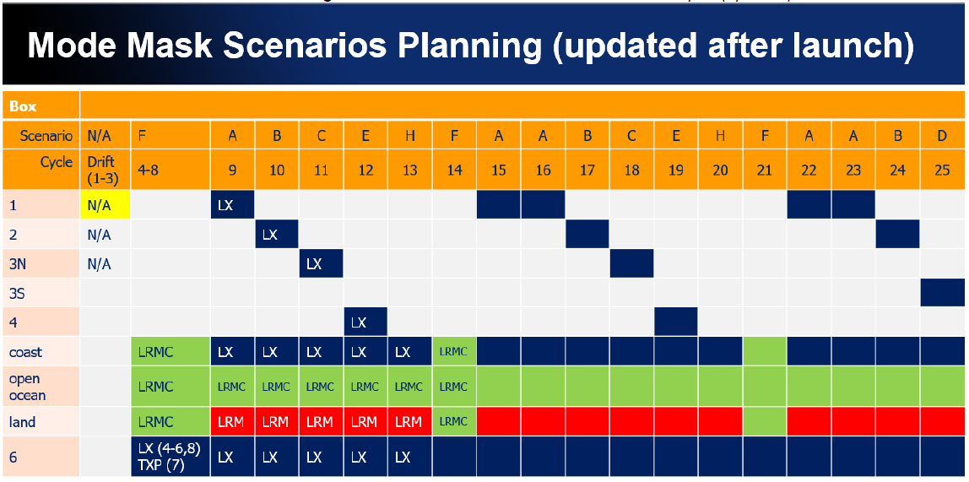

Slide 23
